Slide 1


Slide 2
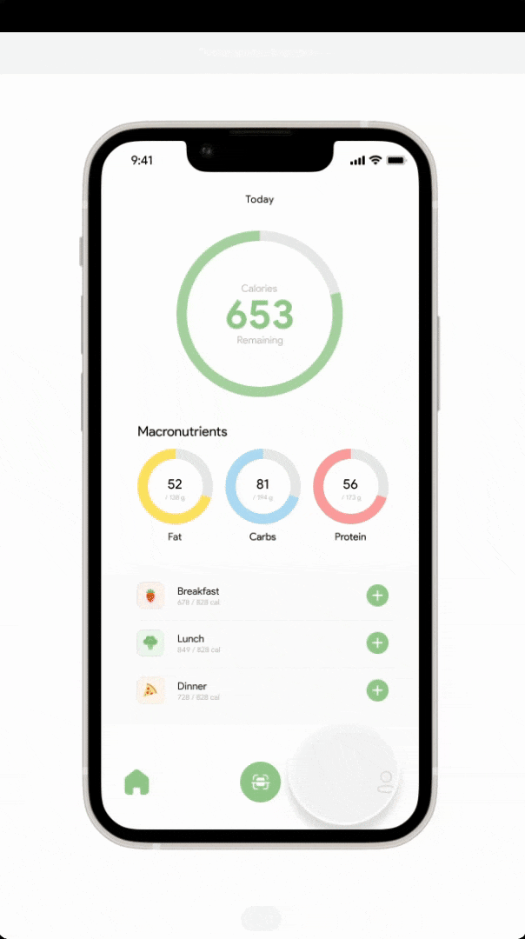

Convenient & revolutionary way of diet tracking Using a Single Photo and AI.
Make Better Choices For Your Health At Every Meal
Free for 4 times each day
Connect with a community and access educational resources.
User engagement to attract a broad audience
Generate traction
Gather feedback for product refinement

Slide 3
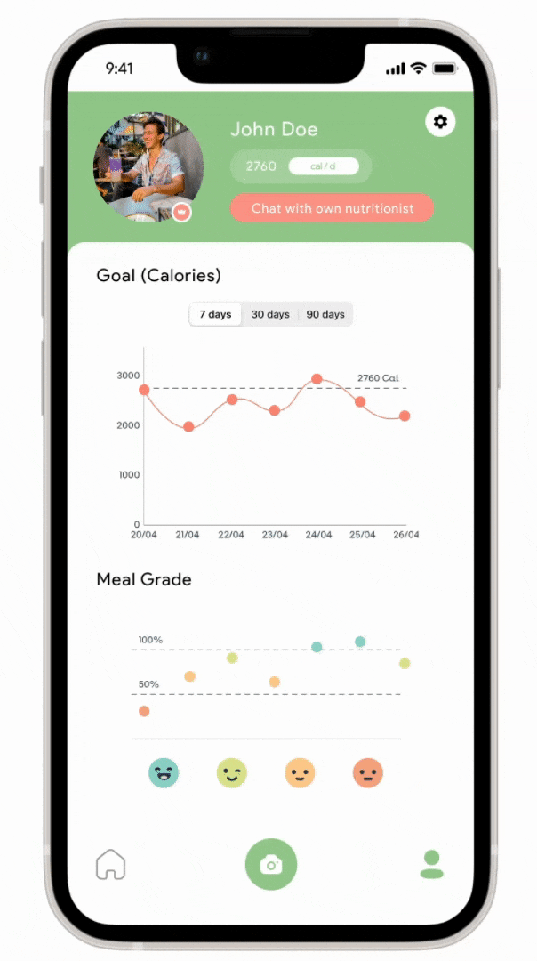
Enjoy more user-friendly app interface with intuitive features and easy navigation, suitable for all skill levels.
Comprehensive nutritional information and personalized tips in a visually engaging format
Limited offering access to chat with nutritionist during working hours
Can analyze most popular Finnish dishes
Build trust and familiarity
Gather user feedback
Convert standard users

Slide 4
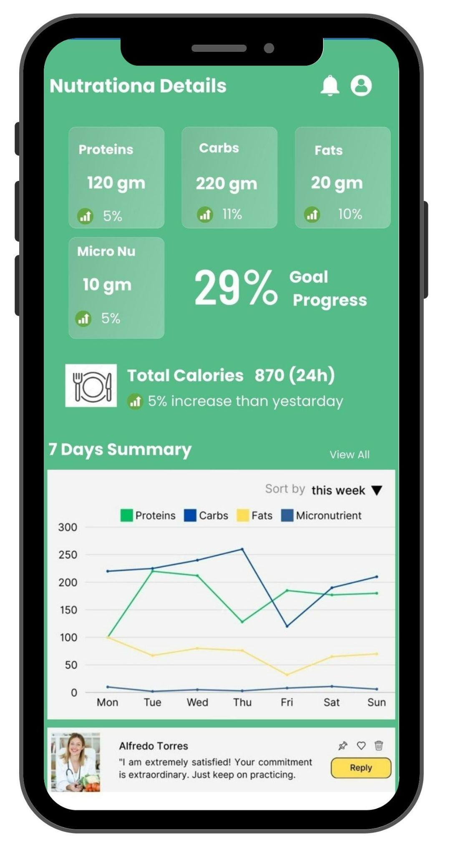
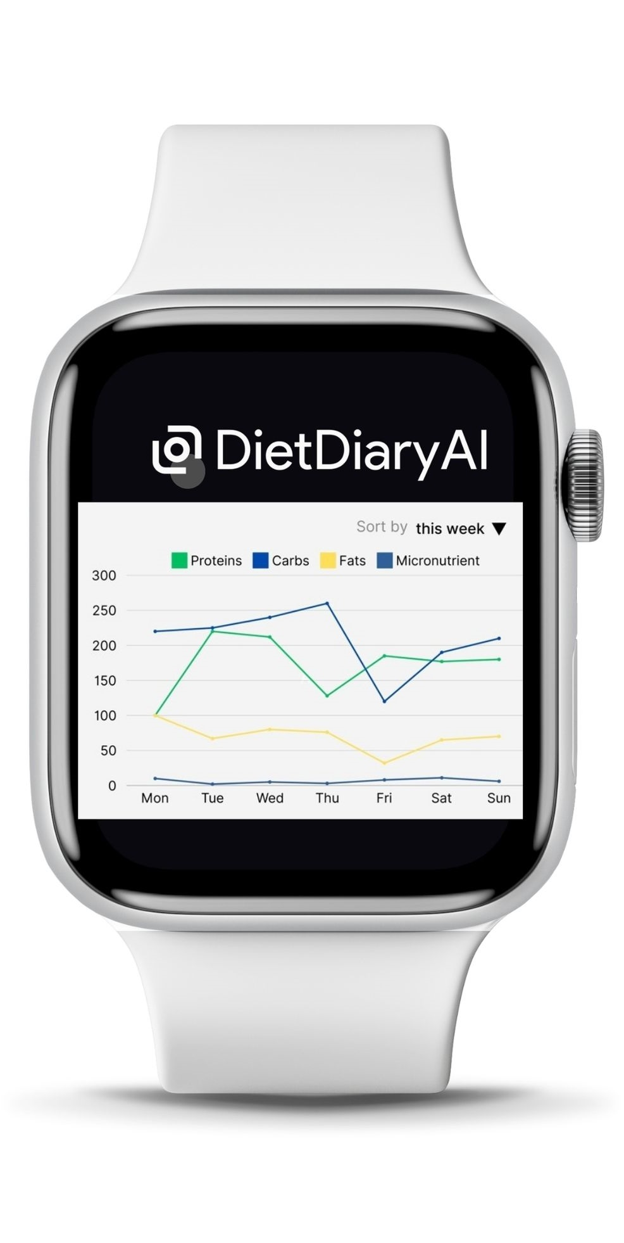
More advanced AI algorithms that produce precise nutritional breakdowns of meals
Personalized meal recommendations based on individual fitness goals
Monitor progress and adjust your diet dynamically for optimal results
Automatic sync with smart watch, other fitness tracking application and email notification
Schedule one-on-one consultations with nutritionists
Revenue collection
Tangible value and benefits
Building a loyal customer base

Slide 5
Desk research outcomes
Viability of diet apps
Fitness app users see better results than non-users
Long term commitments provide better results
Self reporting is a limiting factor
Gamification has mixed results
User segmentation
Demographic differences matter
Already fit people are more invested
Weight loss is the most common target
Trends matter
Exercise identity is very correlated
Generally tech savvy individuals are most likely to use applications and be early adopters
What is most important for an app
Ease of use and low labor
Free or low cost
Perceived accuracy is more important than actual accuracy
Real life changes are more important than app accuracy
Social factors
Entertainment value is not seen as important
Privacy matters
Target segmentation suggestions
People invested and identifying with a fitness lifestyle
Tech-savvy individuals
People attempting weight management
Notes:
SOURCES:
https://www.ncbi.nlm.nih.gov/pmc/articles/PMC4840256/
https://www.ncbi.nlm.nih.gov/pmc/articles/PMC8367144/
https://journals.sagepub.com/doi/10.1177/1357633X15572203?url_ver=Z39.88-2003&rfr_id=ori%3Arid%3Acrossref.org&rfr_dat=cr_pub++0pubmed&
https://americanfitnessindex.org/eating-healthy-nutrition-apps/
https://www-sciencedirect-com.ezproxy.utu.fi/science/article/pii/S0736585319307932#s0060
https://www-sciencedirect-com.ezproxy.utu.fi/science/article/pii/S0747563220300674?via%3Dihub
https://www.proquest.com/docview/2635374939?parentSessionId=9HQTa2qhi3%2BUCzVrJQUZqPDa3KBHoGw9mCLqqPuTgrc%3D&pq-origsite=primo&accountid=14774&sourcetype=Scholarly%20Journals
https://www-tandfonline-com.ezproxy.utu.fi/doi/full/10.1080/10410236.2016.1167998
https://www-sciencedirect-com.ezproxy.utu.fi/science/article/pii/S0969698918306428
https://journals.sagepub.com/doi/10.1177/00469580221095826
https://www.researchgate.net/publication/370442209_Virtual_Dietitian_as_a_Precision_Nutrition_Application_for_Gym_and_Fitness_Enthusiasts_A_Quality_Improvement_Initiative
https://www.perfectgym.com/en/blog/business/fitness-industry-statistics-trends
https://www.etla.fi/en/publications/digibarometri-2021-vuosikymmen-verkkokauppaa-ja-alustataloutta/

Slide 6
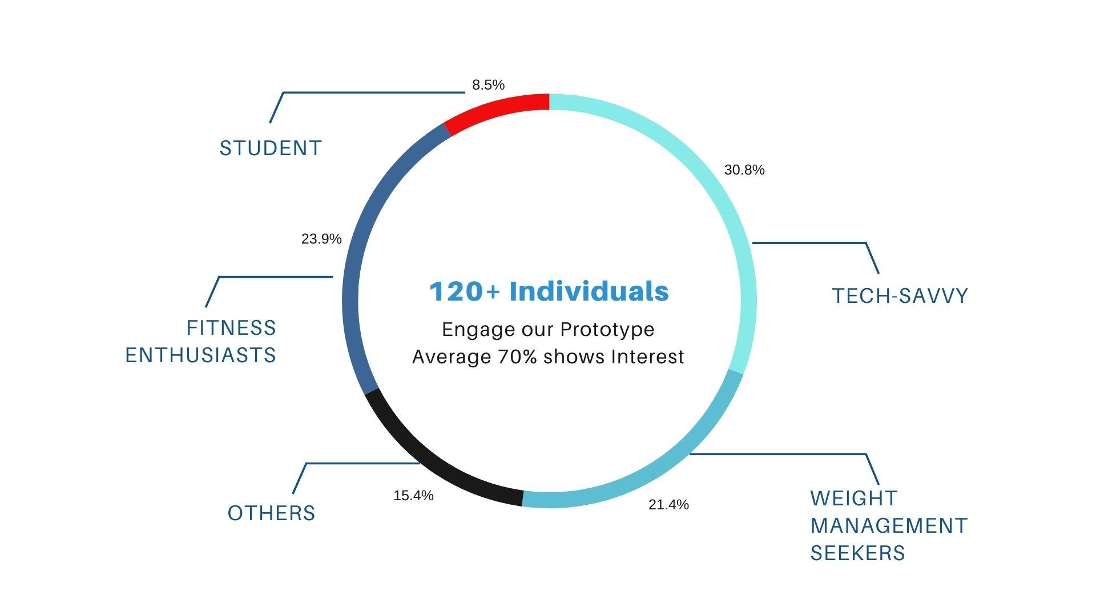
Customer Segmentation
Most relevant identity of interested people - Survey
Chosen Customer Segment
Fitness Enthusiasts
Tech-Savvy Individuals
Weight Management Seekers
Likely Customer profiles
Age- 16 to 64
Location- Nordic Urban People
Technological Adoption- High
Usage Patterns-Mobile app usage
Purchase Behavior- Frequent
Market Size
Fitness Enthusiasts ~1.2 million
Tech-Savvy~1.44 million

Slide 7
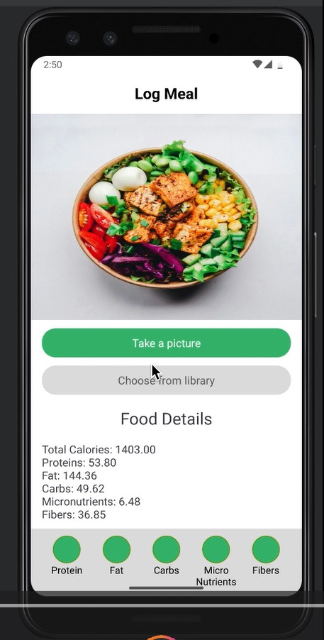
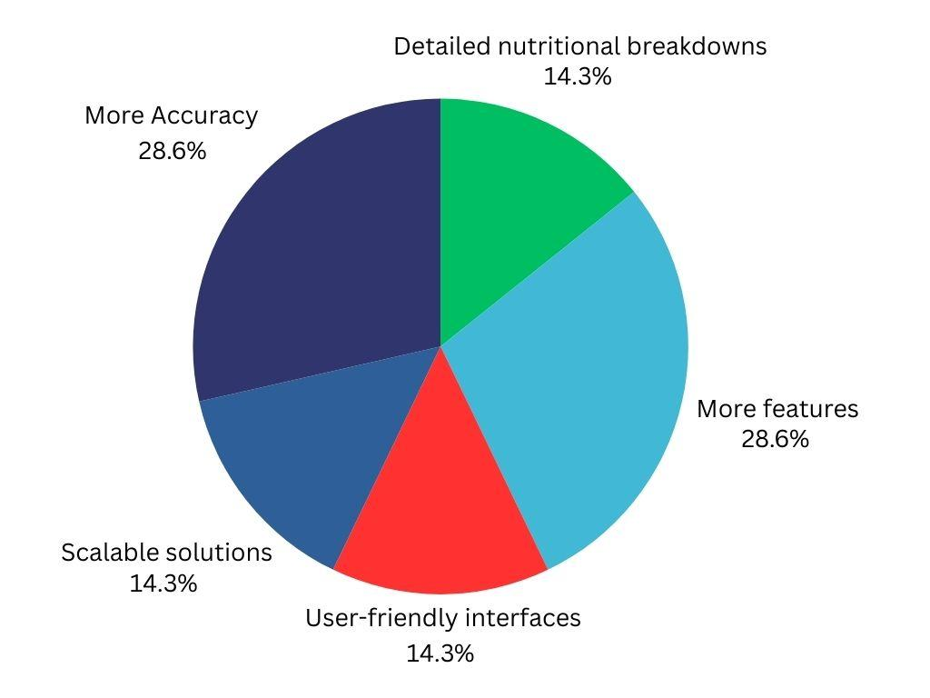

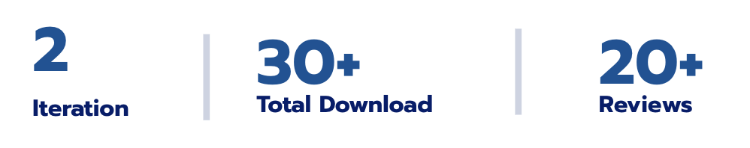
Comprehensive Insight On User Feedback
User Feedback
Updated UI/UX for better user experience and ease of use.
Provide comprehensive details about fat and nutritional components.
Transparency and communication regarding the accuracy
Expand the scope of insights
Personalized recommendations, trends analysis, and actionable tips

Slide 8
Usability Testing Results
85%
Feature Satisfaction
Fitness Enthusiasts express enthusiasm for personalized nutrition recommendations based on fitness goals.
75%
Task Completion Rates
75% of users successfully capture and analyze meal images within the app interface.
45%
Navigation Issues
Encounter difficulty locating specific nutritional information

Slide 9
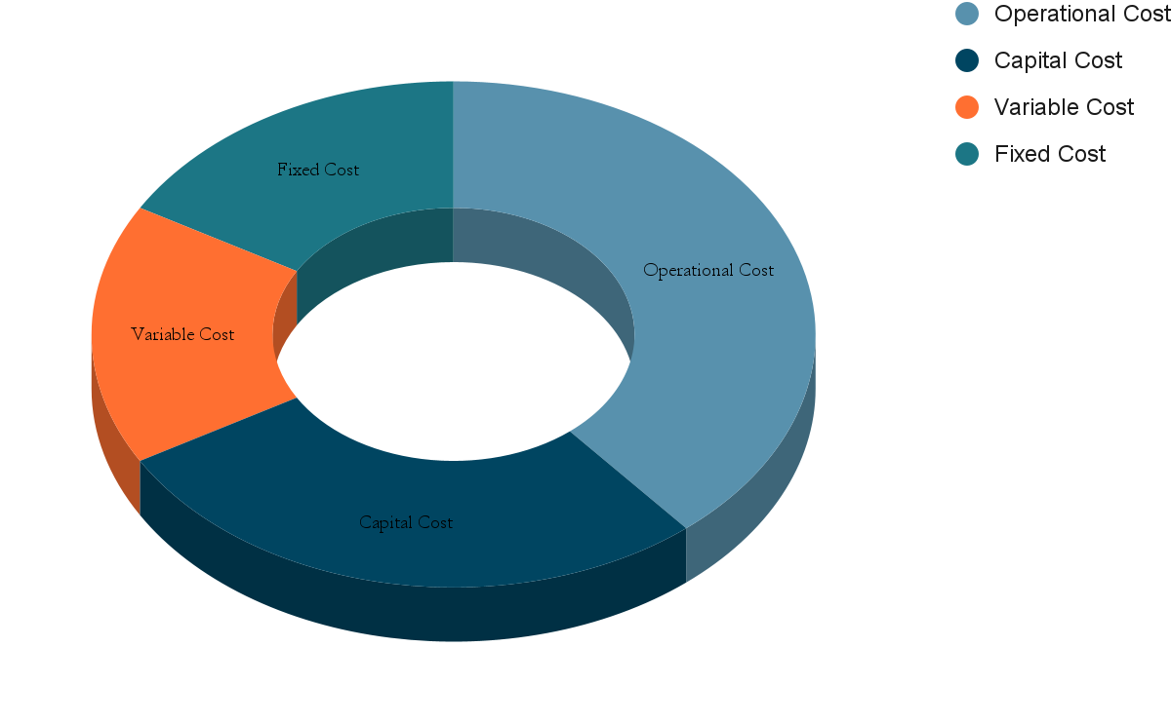
Spending
Product development
UI UX design (Continuous Development)
Marketing and User Acquisition
Technology Infrastructure
Operational Cost
Capital Cost
Research and Development
Creating and optimization of Algorithm
Image repository
Variable Cost
Nutritionists
Campaign specific expenses
Fixed Cost
3rd Party API
iOS and Android platform
Legal and Regulatory Compliance
Office space, utilities

Slide 10
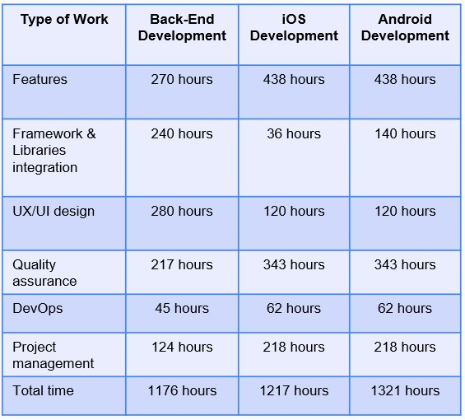
Spending and Revenue
Break Even Point
Only 0.661% of 3.13 billion market
Total Hours: 3115
Average €50
Total €200,000
CAC: €29
Standard Customer
Monthly Plan: 20710
8 Months
Standard Customer
Yearly Plan: 2532
5 Months
Premium Customer
Monthly Plan: 16667
7~8 Months
Premium Customer
Monthly Plan: 2000
4~5 Months

Slide 11


Flexible Pricing Plans For Everyone
Free
Forever
10€
/ month
12€
/ month
Basic
For Everyday Users
Basic meal tracking
Meal planning tools
Standard Customer Support
Standard
For Fitness Enthusiasts
Everything in Basic -plan
Nutrition Recommendations
Detailed Nutrient Analysis
Integration With Fitness Trackers
Advanced Tracking and Analysis
Premium
For Tech-Savvy Individuals
Everything in Standard -plan
Access to Nutritionists feedback
Integration with wearable devices
Exclusive Customer Support
Real time monitoring of progress

Slide 12
Refined Business Model
Customer Segments
Fitness Enthusiasts
Tech-Savvy Individuals
Generalized Customers
Value Proposition
Revolutionary approach to managing nutrition
Personalized Nutrition Insights and Recommendations
Community Engagement and Education
Access to professional nutritionists for tailored advice
Channels
Mobile App (iOS, Android)
Social Media Platforms Influencer Partnerships
Community Engagement
Revenue Streams
Freemium Model
Subscription Plans
In-App Purchases
Advertising
Key Resources
AI Technology (API)
Development Team
Our Own Food Database
Nutrition Experts
Partnerships
Nutritionists
Fitness Brands Wearable Tech
Food Brands
Customer Relationships
Personalized Interactions
Community Engagement
Premium Support
Content and Resources

Slide 13
Thank You!
Do you have any questions or feedback for us?

